Slide 1
GUI and Action Language

Slide 2
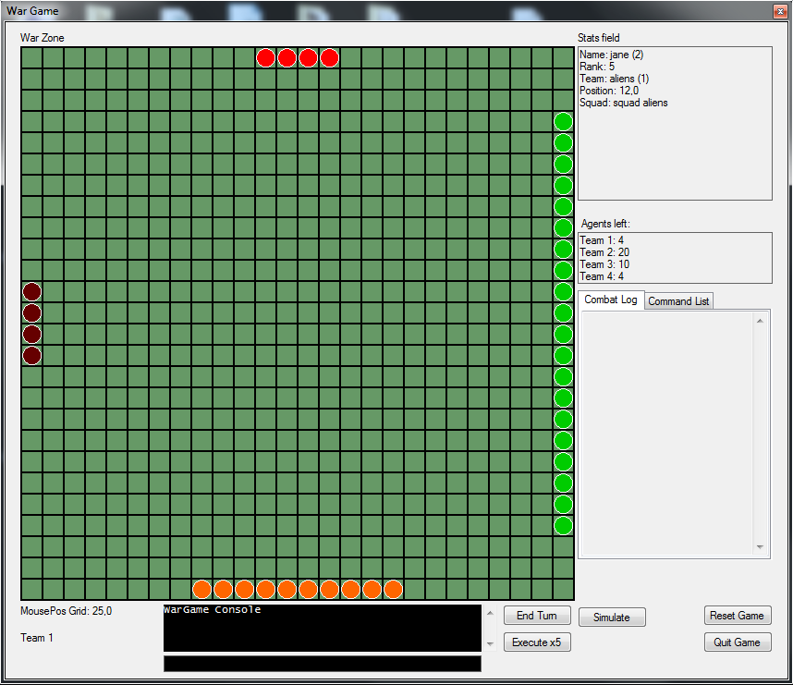
GUI
War Zone
Stats field
Control buttons
Wargame Console

Slide 3
Action Language
Validate commands
Execute commands
”team students jump down”
”team 2 move patrolLow”

Slide 4
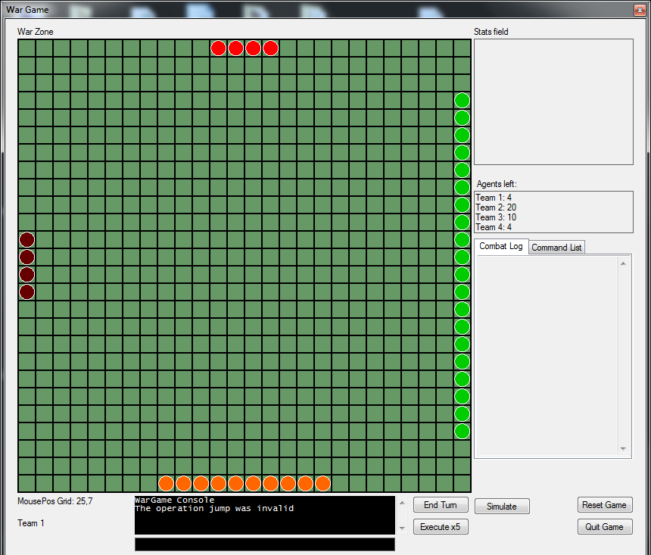
Demonstration - 1

Slide 5
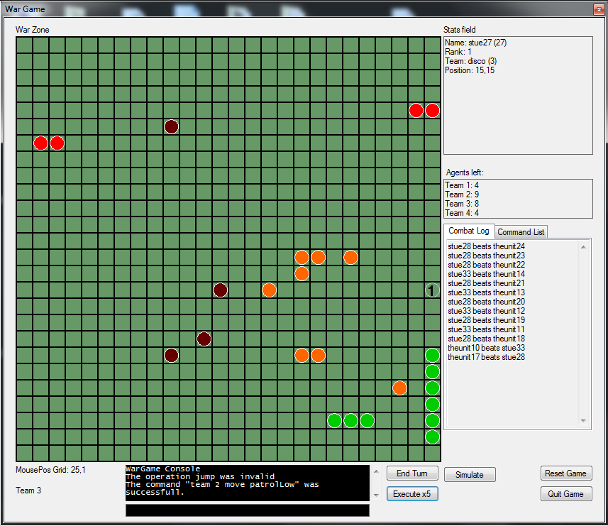
Demonstration - 2

